Slide 1
Topic: Financial Maths EQ: How Do I Calculate Percentage Increase or decrease with dollars ?
Year 8 Mathematics

Slide 2
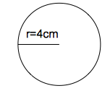

Five Questions (LHS)
Date: XX/XX/2021
Solve for x, x + 2 – 7 = 20
Find 40% of $120
solve for $x$ if $2x+8=26$
Find the circumference of the following circle.
Find the area of the same circle.

Slide 3
24
7
30
Topic: Financial Maths
Date: XX/XX/2021
EQ – How do I calculate percentage increase and decrease?
Question
Examples
Steps
Increase $2,700 by 22%
1. Turn the % into a fraction
2. Multiply by the number
3. Add the new amount to the original number
What is a % Increase?

Slide 4
24
7
30
Topic: Financial Maths
Date: XX/XX/2021
EQ – How do I calculate percentage increase and decrease?
Question
Examples
Steps
Decrease $163 by 45%
1. Turn the % into a fraction
2. Multiply by the number
3. Subtract the new amount to the original number
What is a % Decrease?

Slide 5
24
7
30
Topic: Financial Maths
Date: XX/XX/2021
EQ – How do I calculate percentage increase and decrease?
Question
Examples
Steps
Tori earns $950 per week as an electrician. She receives a pay increase of $32 per week. Find out by how much Tori’s pay increased by as a percentage.
1. Write the amount of the increase as a fraction over the original amount.
2. Multiply by 100%
3. Write the answer as a percent
How to find the %?

Slide 6
LHS – Percentage Increase Practice
Ai) 225 + 1500 ii) 375 + 1500 iii) 675 + 1500 iv) 1800 + 1200 $1725 $1875 $2175 $3000

Slide 7
LHS – Percentage decrease Practice
Bi) 2200 - 220 ii) 2200 - 880 iii) 2200 – 1452 iv) 2200 – 2090
$1980 $1320 $748 $110

Slide 8
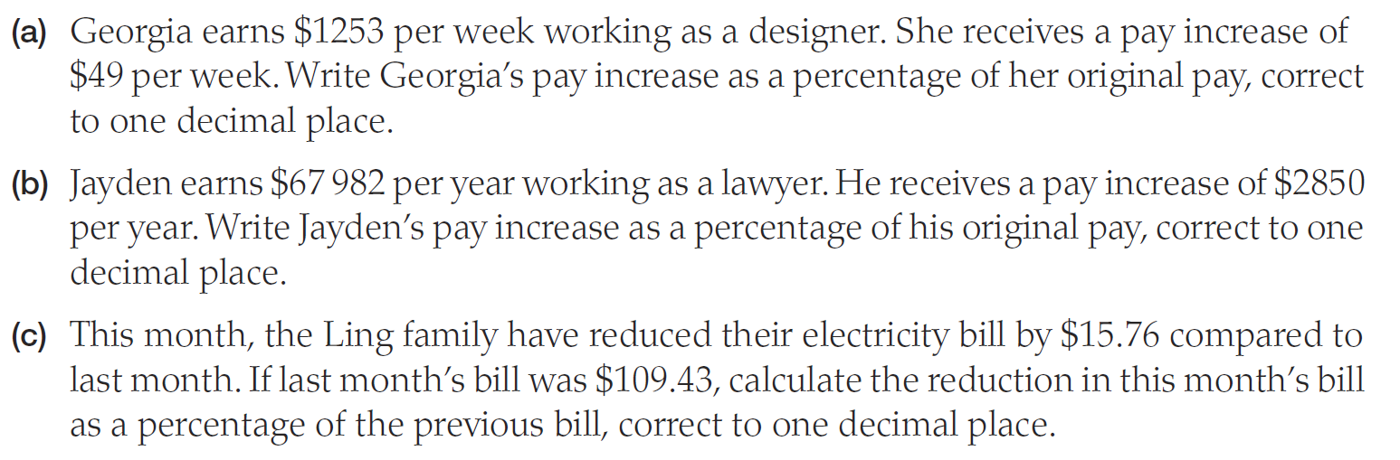
LHS – WheRe is this Maths Used?

Slide 9
LHS – Where is this maths used?

Slide 10
LHS – Where is this maths used?

Slide 11
Percentage share trading game Adapted from Dizzle Education www.dizzleeducation.com
You will need a calculator.
Form a group of 3.

Slide 12
Instructions:
At the start of each round there will be a ‘newsflash’. Your team will need to decide what commodities to invest your $2,000 in
At the end of the round, you will sell all your commodities at the new prices and record how much profit you made that round
At the end of the six rounds, you will work out your overall profit
The winning team is the one that makes the most profit
There will be a fine of $500 for each mathematical mistake a team makes, and any teams that fail to work together will also be fined.
Percentage Trading Game

Slide 13
Current World Market Prices:
Commodity | Price | Amount Invested | Percentage Change | New Price
Oil | $80
Diamonds | $150
Wheat | $60
Gold | $120
Cocoa | $50
Silver | $100
Percentage Trading Game
Percentage Trading Game

Slide 14
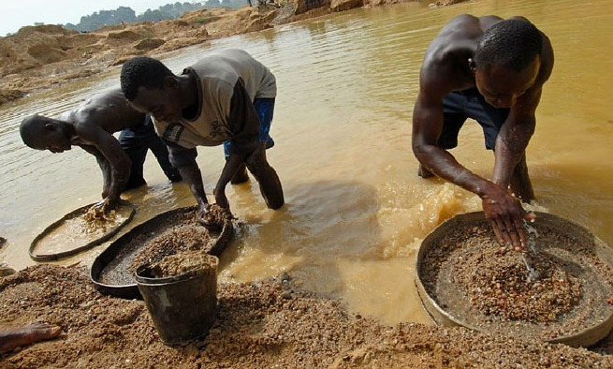
Round 1:
Renewed violence in Sierra Leone scares off international investors
Percentage Trading Game
Percentage Trading Game

Slide 15
World Market Price Changes after Round 1:
Commodity | Price | Percentage Change
Oil | $80 | +10%
Diamonds | $150 | +40%
Wheat | $60 | 0
Gold | $120 | +20%
Cocoa | $50 | 0
Silver | $100 | 0
Percentage Trading Game
Percentage Trading Game

Slide 16
Current World Market Prices:
Commodity | Price | Amount Invested | Percentage Change | New Price
Oil | $80 |  | +10%
Diamonds | $150 |  | +40%
Wheat | $60 |  | 0
Gold | $120 |  | +20%
Cocoa | $50 |  | 0
Silver | $100 |  | 0
Percentage Trading Game
Percentage Trading Game

Slide 17
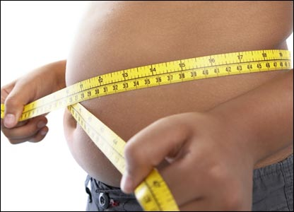
Round 2:
New worldwide obesity campaign launched
Percentage Trading Game
Percentage Trading Game

Slide 18
World Market Price Changes after Round 2:
Commodity | Price | Percentage Change
Oil | $80 | + 5%
Diamonds | $150 | 0
Wheat | $60 | - 10%
Gold | $120 | + 1%
Cocoa | $50 | - 15%
Silver | $100 | -40%
Percentage Trading Game
Percentage Trading Game

Slide 19
Current World Market Prices:
Commodity | Price | Amount Invested | Percentage Change | New Price
Oil | $80 |  | + 5%
Diamonds | $150 |  | 0
Wheat | $60 |  | - 10%
Gold | $120 |  | + 1%
Cocoa | $50 |  | - 15%
Silver | $100 |  | -40%
Percentage Trading Game
Percentage Trading Game

Slide 20

Round 3:
Storms devastate harvest across Russia and Eastern Europe
Percentage Trading Game
Percentage Trading Game

Slide 21
World Market Price Changes after Round 3:
Commodity | Price | Percentage Change
Oil | $80 | + 15%
Diamonds | $150 | 0
Wheat | $60 | + 60%
Gold | $120 | + 10%
Cocoa | $50 | 0
Silver | $100 | + 5%
Percentage Trading Game

Slide 22
Current World Market Prices:
Commodity | Price | Amount Invested | Percentage Change | New Price
Oil | $80 |  | + 15%
Diamonds | $150 |  | 0
Wheat | $60 |  | + 60%
Gold | $120 |  | + 10%
Cocoa | $50 |  | 0
Silver | $100 |  | + 5%
Percentage Trading Game
Percentage Trading Game

Slide 23
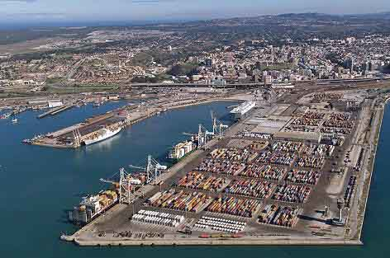
Round 4:
Long-running strikes in South Africa reduce the country’s exports
Percentage Trading Game

Slide 24
World Market Price Changes after Round 4:
Commodity | Price | Percentage Change
Oil | $80 | +15%
Diamonds | $150 | +45%
Wheat | $60 | 0
Gold | $120 | +60%
Cocoa | $50 | 0
Silver | $100 | +55%
Percentage Trading Game

Slide 25
Current World Market Prices:
Commodity | Price | Amount Invested | Percentage Change | New Price
Oil | $80 |  | +15%
Diamonds | $150 |  | +45%
Wheat | $60 |  | 0
Gold | $120 |  | +60%
Cocoa | $50 |  | 0
Silver | $100 |  | +55%
Percentage Trading Game
Percentage Trading Game

Slide 26
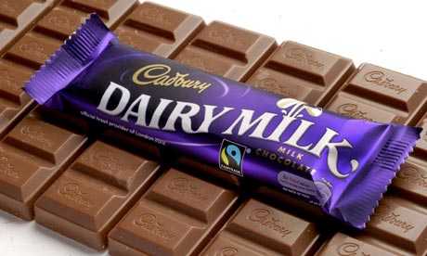
Round 5:
Fairtrade fortnight boosts Cadbury's revenues
Percentage Trading Game

Slide 27
World Market Price Changes after Round 5:
Commodity | Price | Percentage Change
Oil | $80 | +10%
Diamonds | $150 | 0
Wheat | $60 | 0
Gold | $120 | 0
Cocoa | $50 | +36%
Silver | $100 | 0
Percentage Trading Game

Slide 28
Current World Market Prices:
Commodity | Price | Amount Invested | Percentage Change | New Price
Oil | $80 |  | +10%
Diamonds | $150 |  | 0
Wheat | $60 |  | 0
Gold | $120 |  | 0
Cocoa | $50 |  | +36%
Silver | $100 |  | 0
Percentage Trading Game
Percentage Trading Game

Slide 29
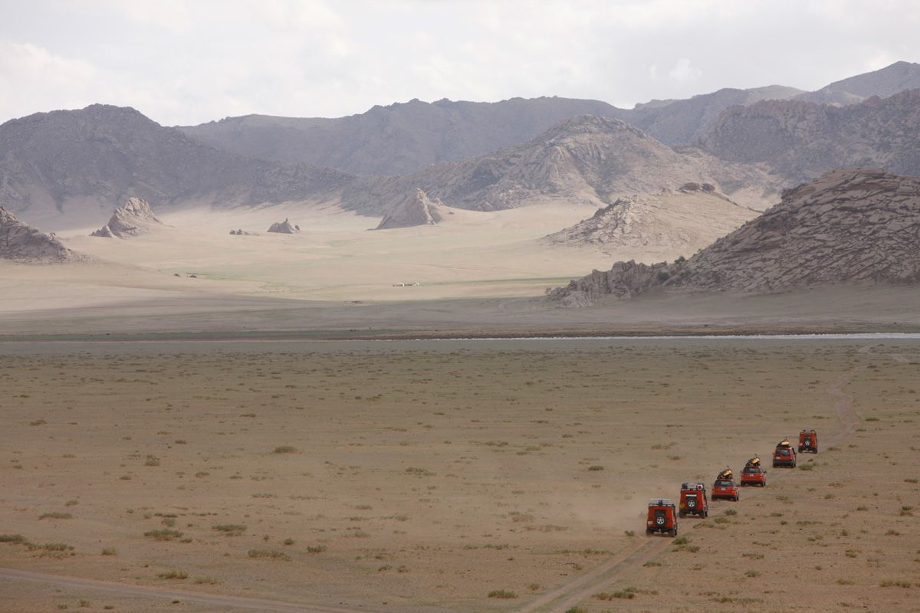
Round 6:
Mongolia’s economy may grow by 25% if foreign investment takes off
Percentage Trading Game

Slide 30
World Market Price Changes after Round 6:
Commodity | Price | Percentage Change
Oil | $80 | +15%
Diamonds | $150 | 0
Wheat | $60 | 0
Gold | $120 | +40%
Cocoa | $50 | 0
Silver | $100 | +57%
Percentage Trading Game

Slide 31
Current World Market Prices:
Commodity | Price | Amount Invested | Percentage Change | New Price
Oil | $80 |  | +15%
Diamonds | $150 |  | 0
Wheat | $60 |  | 0
Gold | $120 |  | +40%
Cocoa | $50 |  | 0
Silver | $100 |  | +57%
Percentage Trading Game
Percentage Trading Game

Slide 32
The End:
Calculate your ‘final profit’ by adding up the total profit you made in each round
Questions to consider:
When did you make the most profit?
Why was this?
Why is it important to be able to quickly complete percentage calculations?
Percentage Trading Game

